Slide 1

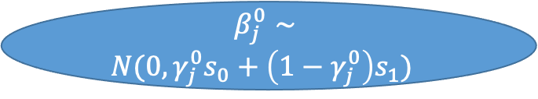
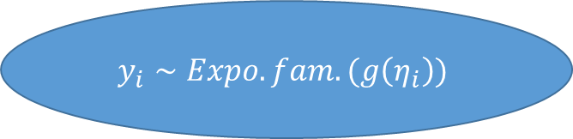
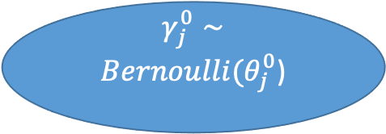
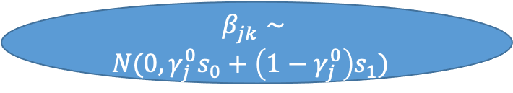

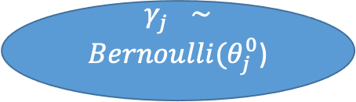


$$θ_{j}^{0}∼Beta(a, b)$$
$$(a, b)$$
$$θ_{j}^{}∼Beta(a, b)$$
$$γ_{j}^{0}∼$$
$Bernoulli(θ_{j}^{0}$)
$$γ_{j}^{}∼$$
$Bernoulli(θ_{j}^{0}$)
$$β_{j}^{0}∼$$
$$N(0, γ_{j}^{0}s_{0}+\left(1−γ_{j}^{0}\right)s_{1})$$
$$(s_{0}, s_{1})$$
$$β_{jk}^{}∼$$
$$N(0, γ_{j}^{0}s_{0}+\left(1−γ_{j}^{0}\right)s_{1})$$
$$\backslash bold β={\left(β_{1}^{0} , β_{1}^{},…, β_{j}^{0}, β_{j}^{}, …, β_{p}^{0}, β_{p}^{}\right)}^{T}$$
$$y_{i}∼Expo. fam.(g\left(η_{i}\right))$$

